Slide 2
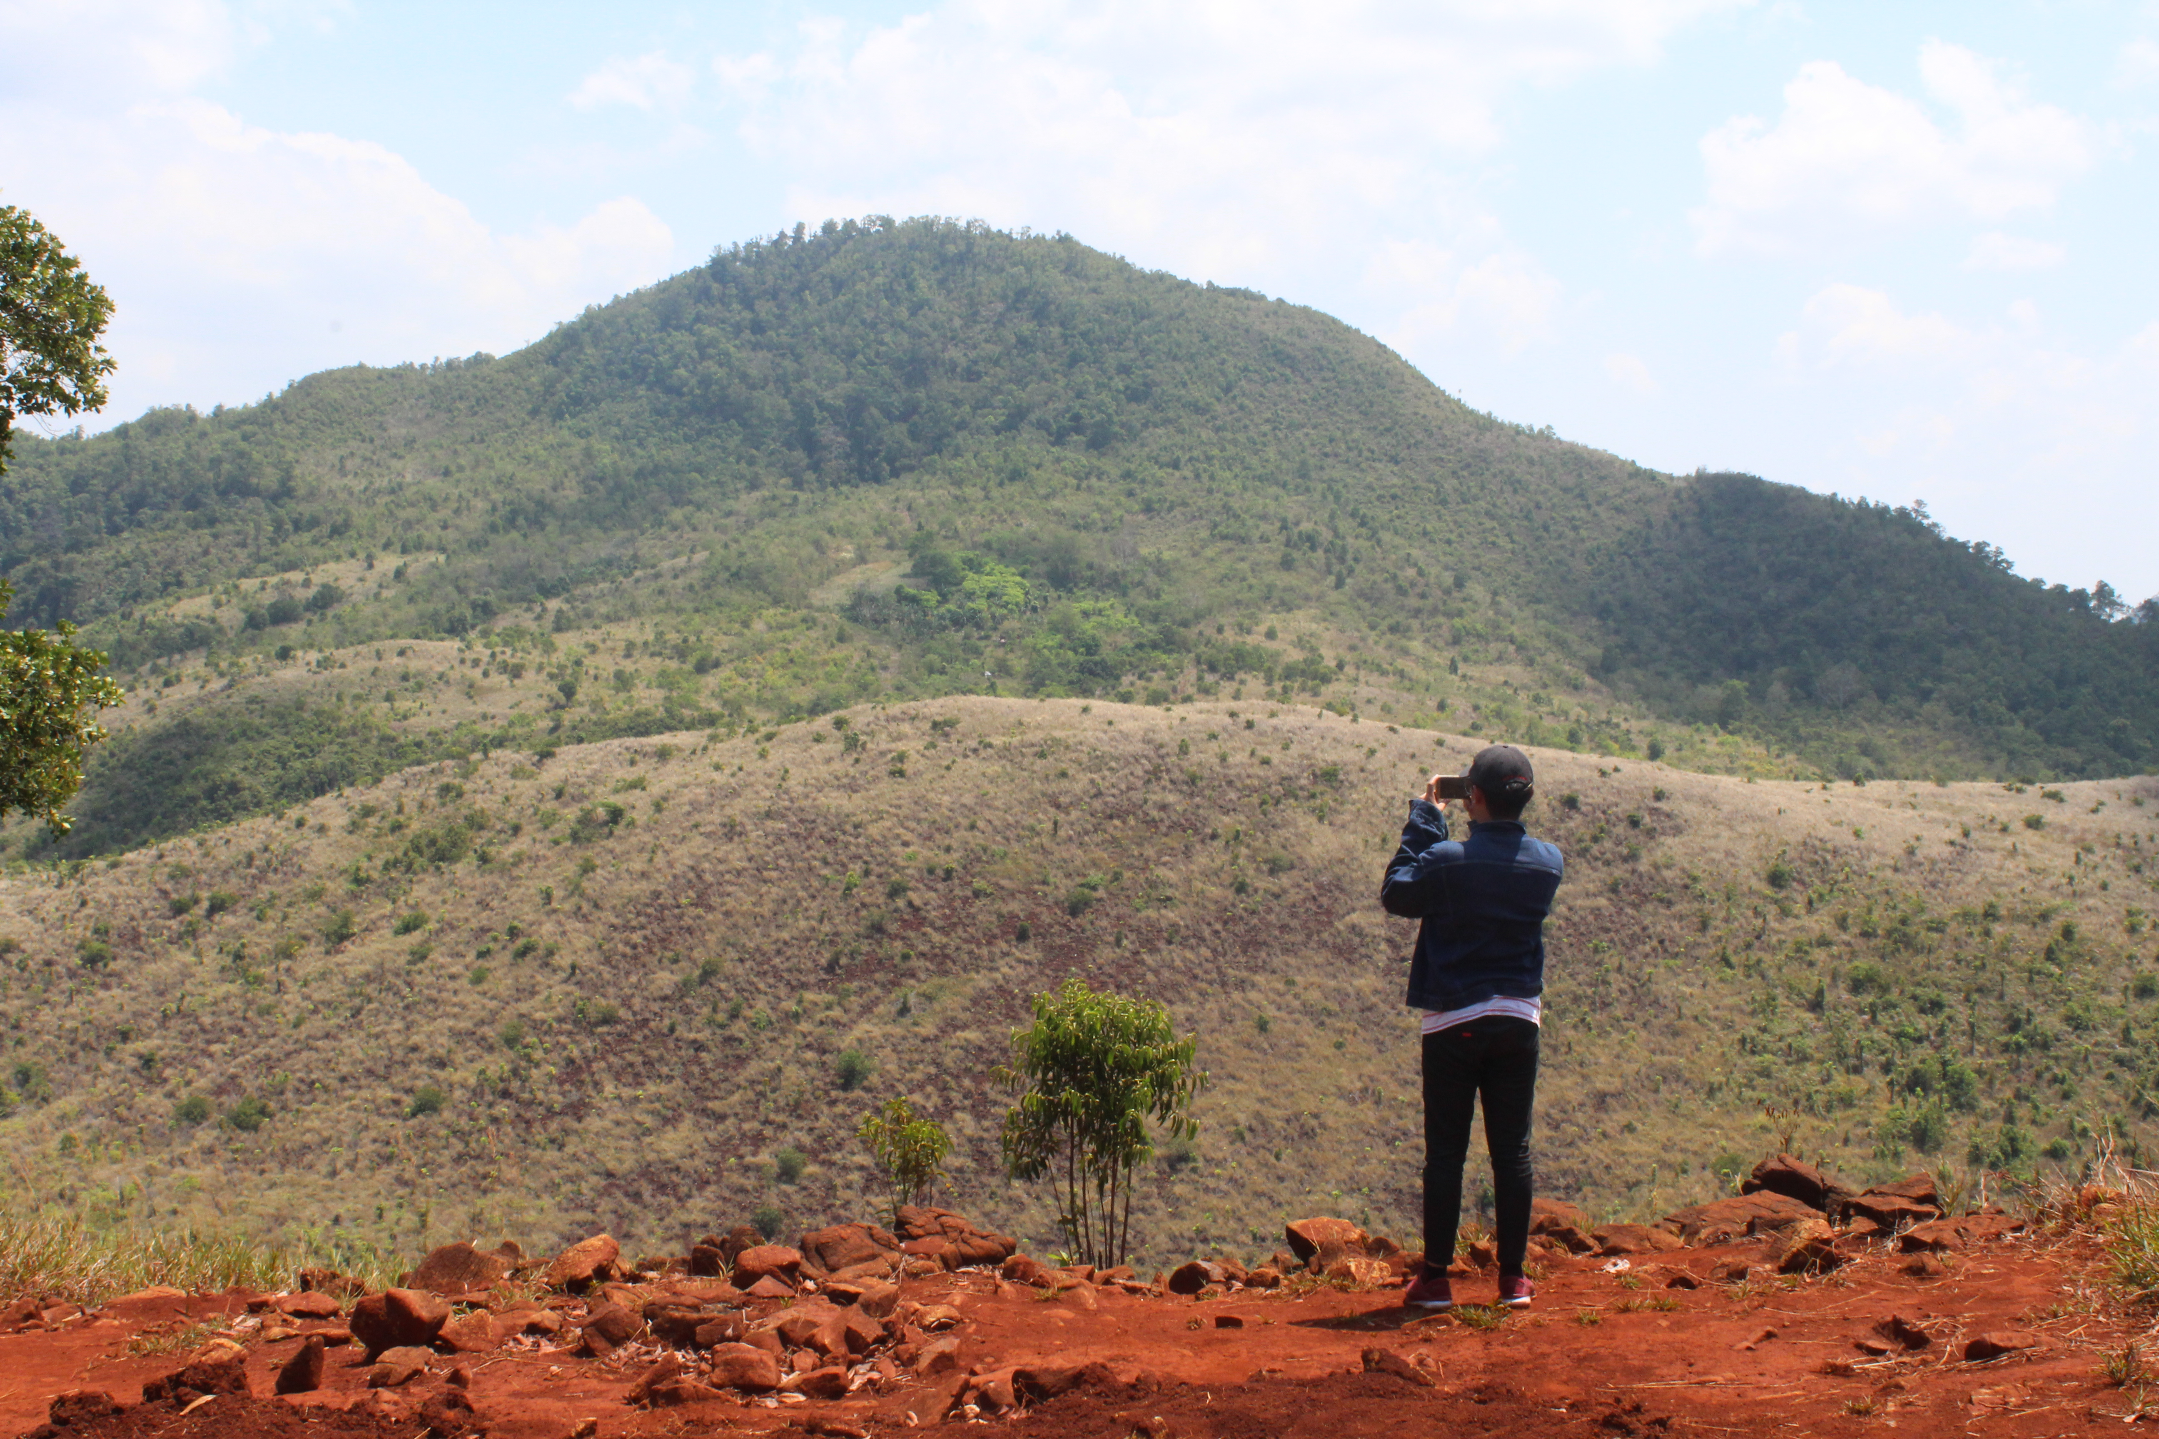
Good
Morning
N
W
E
S
Selamat Pagi
Magandang Umaga
Notes:
A template for students to design a field trip to a location for other students to view. Includes directions to the student of what to include on each slide and what content should be considered.

Slide 3
HOW ARE YOU?
APA KABAR?
KUMUSTA KA?

Slide 4
What did you do last weekend?
WEEKEND
SATURDAY
SUNDAY

Slide 5
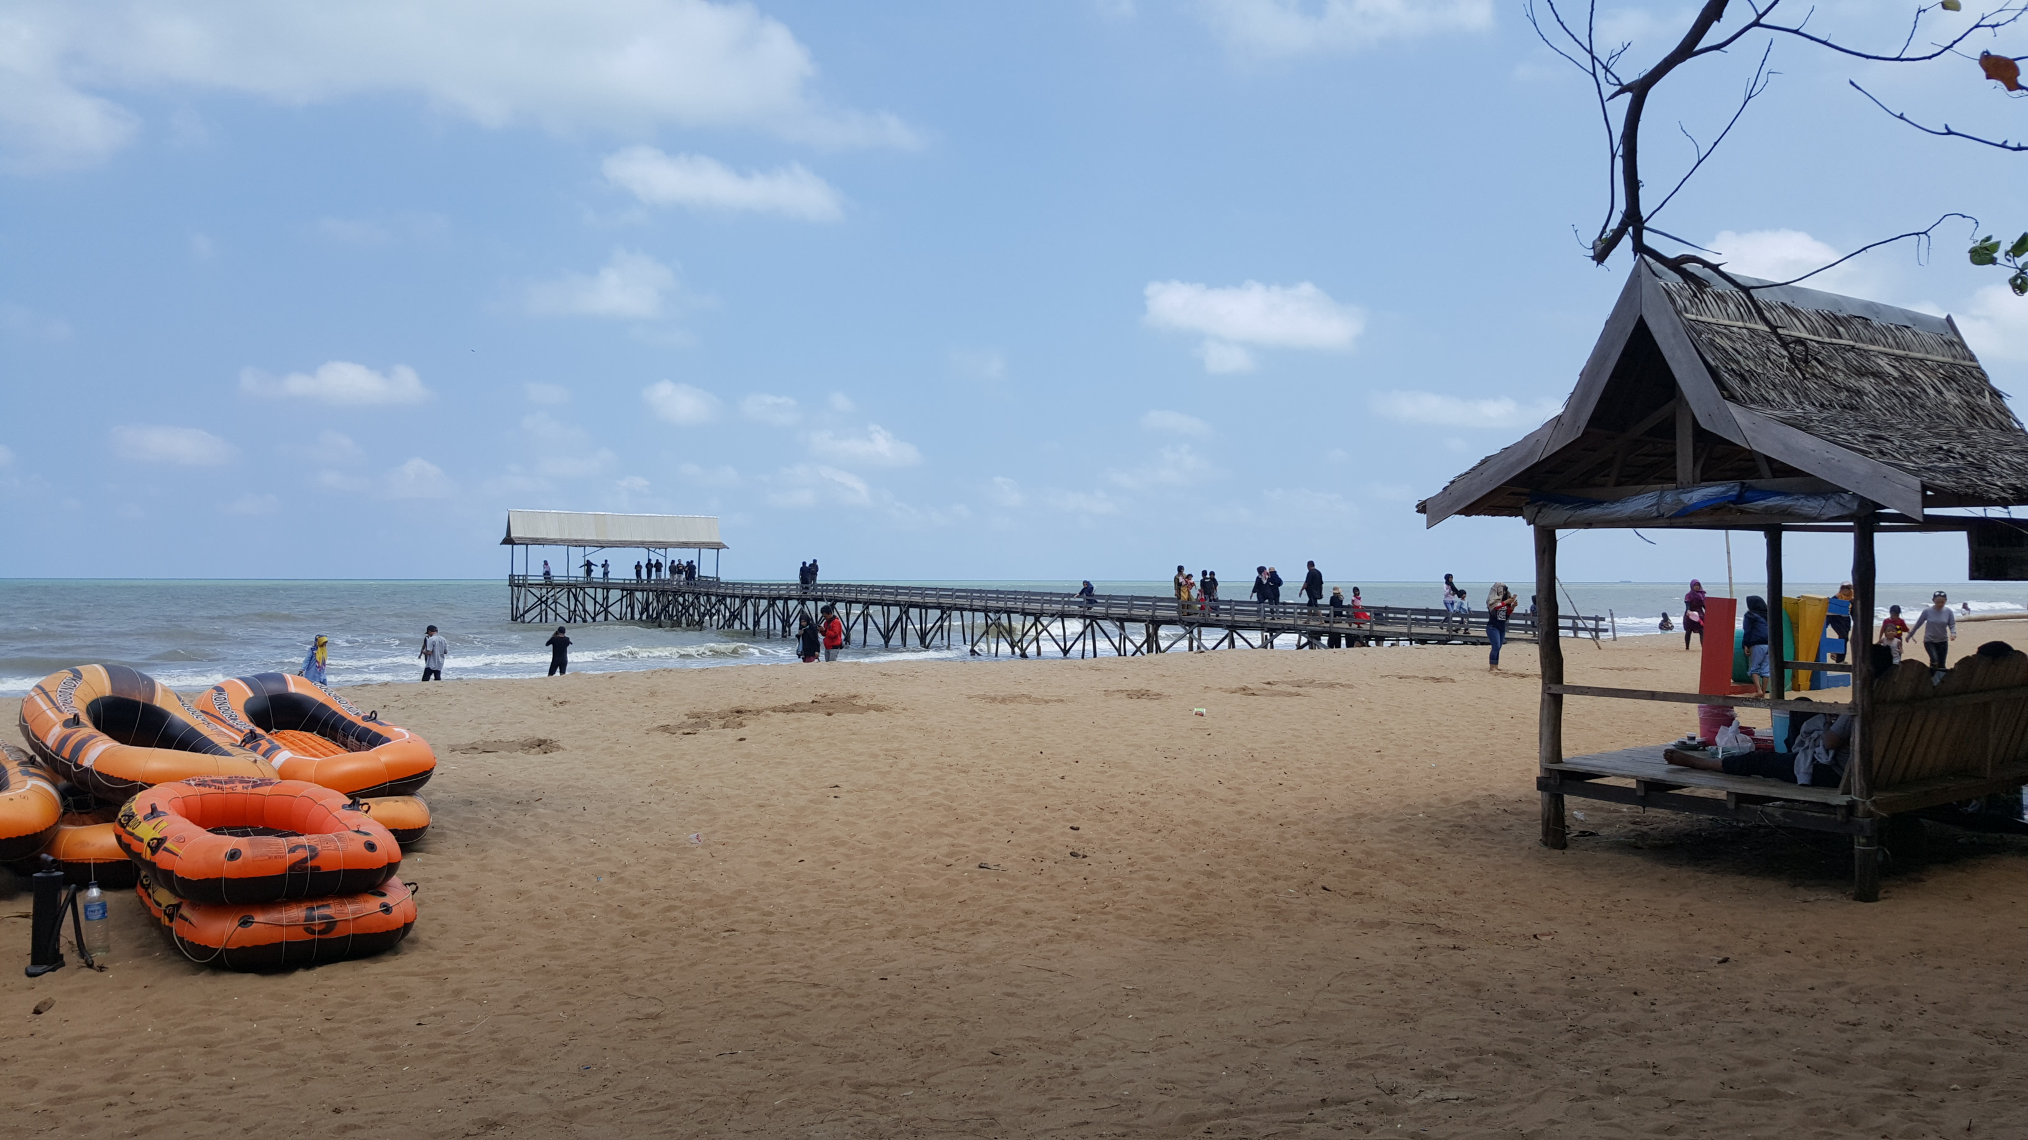
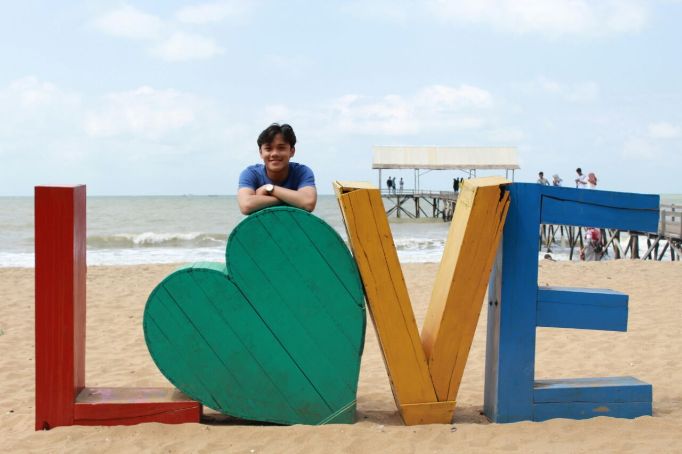
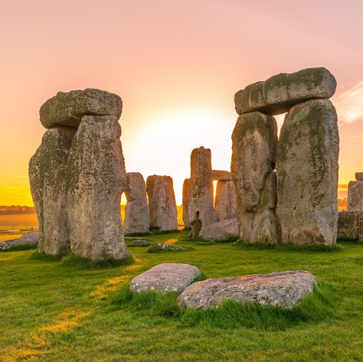
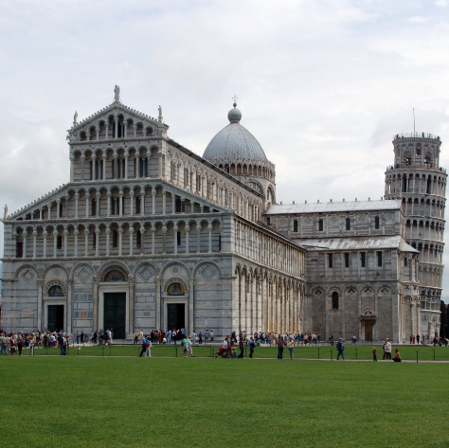
I went to Pantai Asmara.

Slide 6
YOU?
What did you do last weekend?

Slide 7
The “STOP AND TALK” GAME

Slide 8
CHOOSE A NUMBER
1
2
3
4
5
6
7
8

Slide 9
“I would like to go to Duta mall.”
1
READ:
ASK:
“Would you go with me?”

Slide 10
“I want to watch movies.”
2
READ:
ASK:
“Will you watch with me?”

Slide 11
“I will go to Siring tonight.”
3
READ:
ASK:
“Will you go with me?”

Slide 12
“I would like to see the Bakantan.”
4
READ:
ASK:
“Will you go with me?”

Slide 13
“I want some chocolates.”
5
READ:
ASK:
“Will you give me?”

Slide 14
“I am going to eat Nasi Kuneng.”
6
READ:
ASK:
“Will you go with me?”

Slide 15
“I would like to fix my room.”
7
READ:
ASK:
“Will you help me?”

Slide 16
“I want to play.”
8
READ:
ASK:
“Will you play with me?”

Slide 17
LESSON:
Expressing
INTENTION

Slide 18
OBJECTIVES
identify the social function of showing intention;
distinguish the meaning of various phrases regarding the intention of doing an action/activity;
complete sentences by giving the appropriate word/s or phrase; and
respond accordingly to questions showing intention.

Slide 19
INTENTION
The thing you plan to do or achieve
An aim or purpose

Slide 20
EXAMPLES:
I would like to …
I will …
I want to …
I am going to …

Slide 21
EXAMPLES:
I would like to tell about my hobbies.
I will visit the museum.
I want to teach at SMKM 3.
I am going to introduce my friend.

Slide 22

QUESTIONS?

Slide 23
2 WAYS to express
INTENTION
QUESTION?
STATEMENT

Slide 24
“I want to watch movies.”
STATEMENT
READ:
QUESTION?
ASK:
“Will you watch with me?”

Slide 25
“I would like to go to Duta mall.”
STATEMENT
READ:
QUESTION?
ASK:
“Would you like to go?”

Slide 26
“I will go to Siring tonight.”
STATEMENT
READ:
QUESTION?
ASK:
“Will you go with me?”

Slide 27




RESPONDING TO
QUESTION
?
AGREE
DISAGREE
YES
NO

Slide 28
“I will go to Podang’s.”
STATEMENT
QUESTION?
“Will you go with me?”
RESPONSE:
YES
NO

Slide 29
“I want to watch movies.”
STATEMENT
QUESTION?
“Will you watch with me?”
RESPONSE:
YES
NO

Slide 30
“I would like to swim.”
STATEMENT
QUESTION?
“Will you swim with me?”
RESPONSE:
YES
NO

Slide 31
QUESTIONS?

Slide 32
GROUP
Count off 1-10
Draw any place you would like to go to.

Slide 33



DRAW be
CREATIVE and have
FUN

Slide 34
INTENTION
STATEMENT
QUESTION
RESPONSE

